Slide 1
Working Principle of DC Generator

Slide 2
There are two types of generators
DC generators and
AC generators.
Both dc and ac generators convert mechanical power to electrical power.
A dc generator produces direct power, while an ac generator produces alternating power.
Both of these generators produce electrical power based on the principle of faraday’s law of electromagnetic induction.
This law states that when a conductor moves in a magnetic field it cuts magnetic lines of force, which induces an electromagnetic force (emf) in the conductor.
The magnitude of this induced emf depends upon the rate of change of flux (magnetic line force) linkage with the conductor.
This emf will cause a current to flow if the conductor circuit is closed.

Slide 3
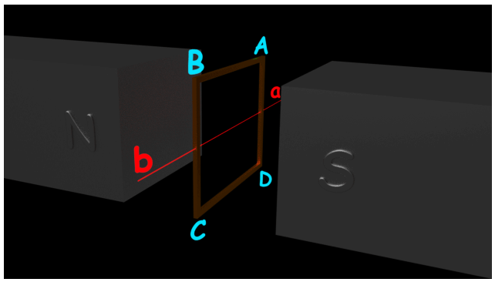
the figure above, a single loop of conductor of rectangular shape is placed between two opposite poles of magnet.
Let’s us consider, the rectangular loop of the conductor is ABCD which rotates inside the magnetic field about its axis ab.
When the loop rotates from its vertical position to its horizontal position, it cuts the flux lines of the field.
As during this movement two sides, i.e., AB and CD of the loop cut the flux lines there will be an EMF induced in these both of the sides (AB and BC) of the loop.

Slide 4
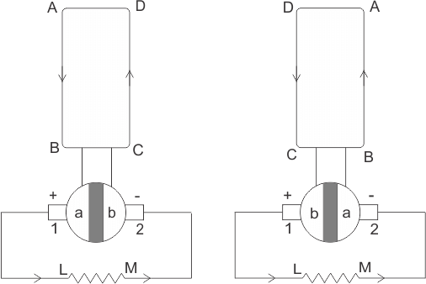
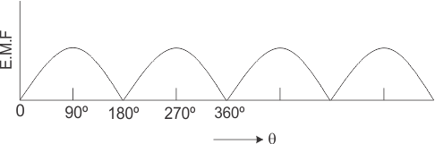
We can see that in the first half of the revolution current always flows along ABLMCD, i.e., brush no 1 in contact with segment a.
In the next half revolution, in the figure, the direction of the induced current in the coil is reversed.
But at the same time the position of the segments a and b are also reversed which results that brush no 1 comes in touch with the segment b. Hence, the current in the load resistance again flows from L to M.
The waveform of the current through the load circuit is as shown in the figure. This current is unidirectional.

